Slide 1

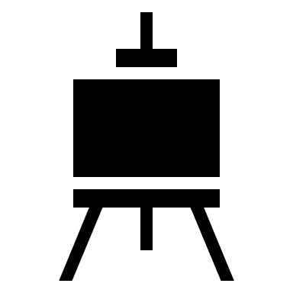


Visual Techniques Course- DAY 1
Introduction
What are different types of Visual Techniques
Get to know the famous artist
Heart Work Activity

Slide 2
Introduction
Visual Techniques

Slide 3
Visual Techniques
is the design and creation of visual communications, requires the selection and application of method, media, materials, design elements, design principles and final presentation.

Slide 4
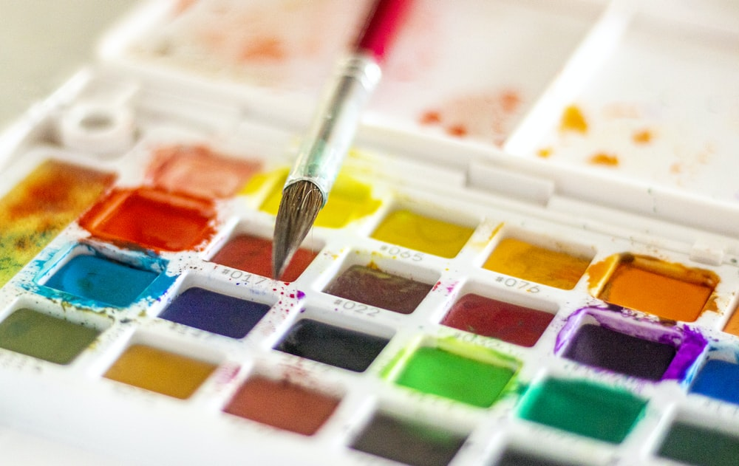
Different Types of Visual Techniques
Water Color Technique
is a simple coloring medium. Can be done on drywash, wet wash, wet-in-wet, underpainting and color blending.
Image: unsplash

Slide 5
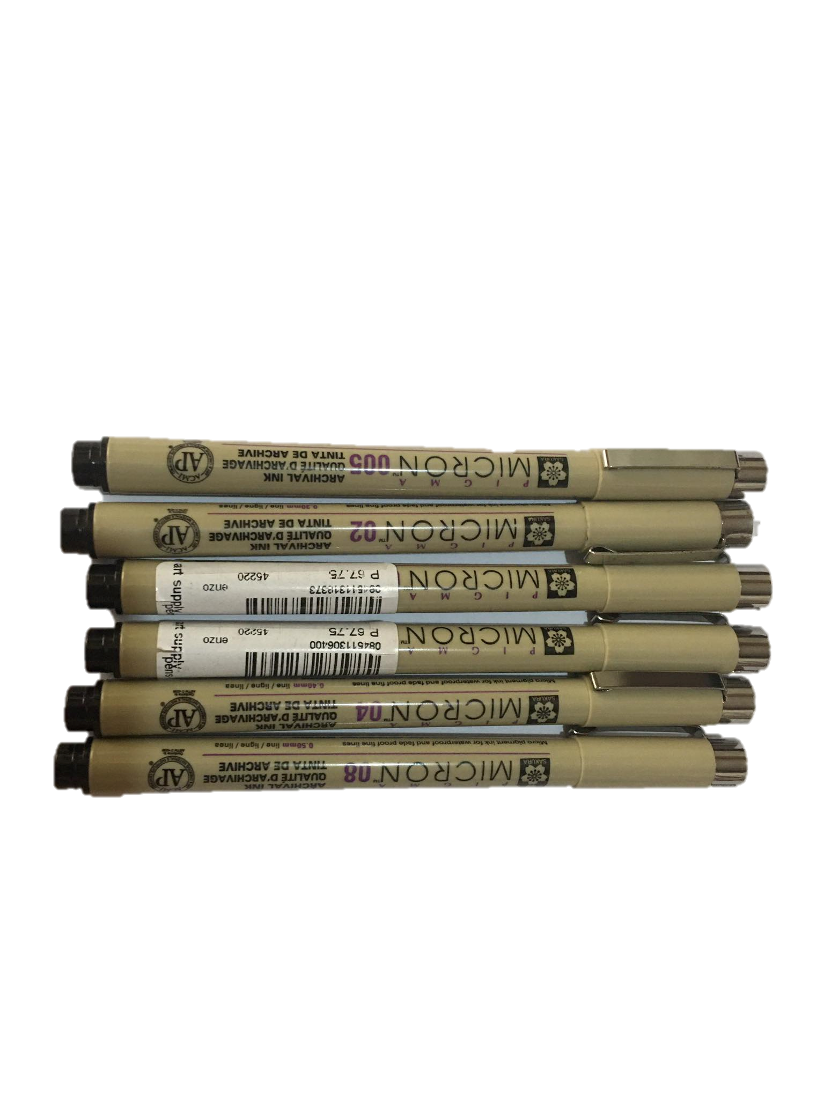
Different Types of Visual Techniques
2. Pen and Ink Technique
use of different types of ballpoint/ pen.
Example: hatching, cross hatching, contour, cross contour, contrasting lines, stippling, doodles.

Slide 6
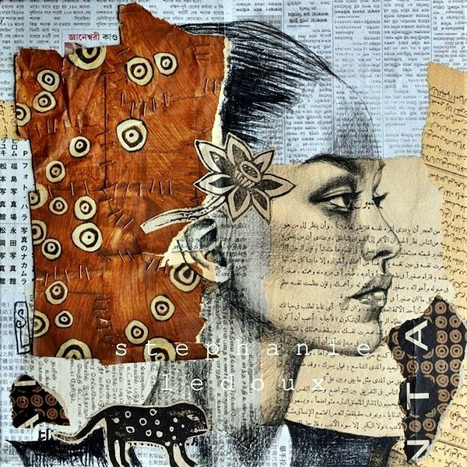
Different Types of Visual Techniques
3. Mixed Media Technique
Made out of more than one medium.
Example: painting, drawing, layering, collaging, texturizing, graffito, create peeled paint effect, monoprinting, frottage, rubbing, slicing, weaving.
image from Google

Slide 7
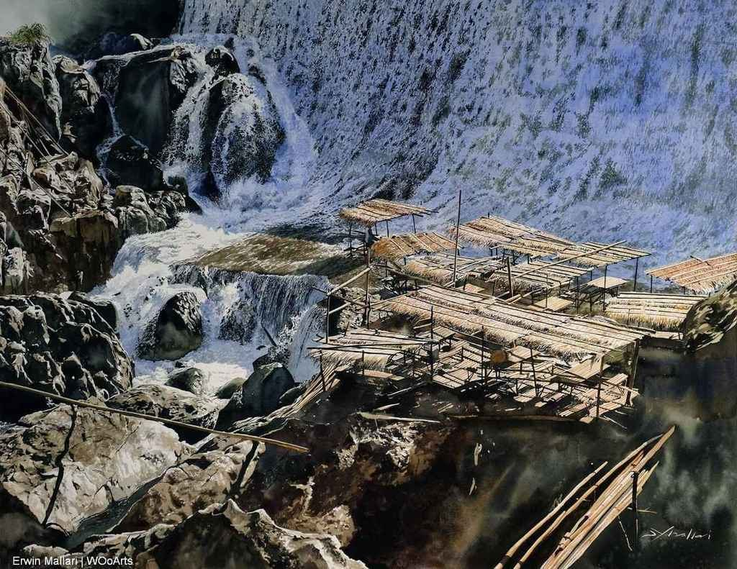
Get to Know the Famous Artist
Erwin Mallari
Famous Watercolor Artist in the Philippines
Paints different places in Metro Manila
Famous paintings: Life on Water
image from Google
Life on Water

Slide 8
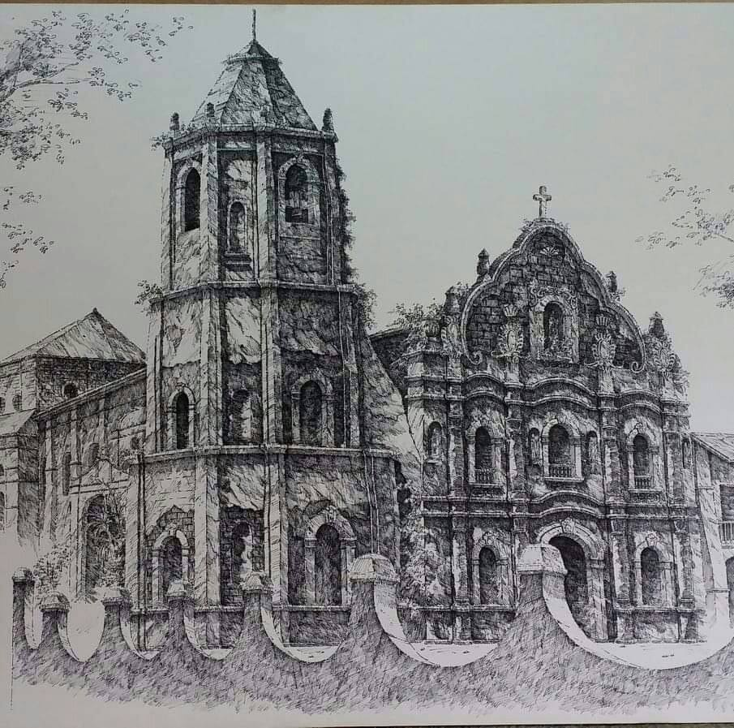
Get to Know the Famous Artist
Noel Bueza
Known as the master of Pen and Ink Artist in the Philippines
Known for his arts on old churches, houses and flowers.
image from Google
San Bartolome Apostol Parish Church in Nagcarlan, Laguna

Slide 9
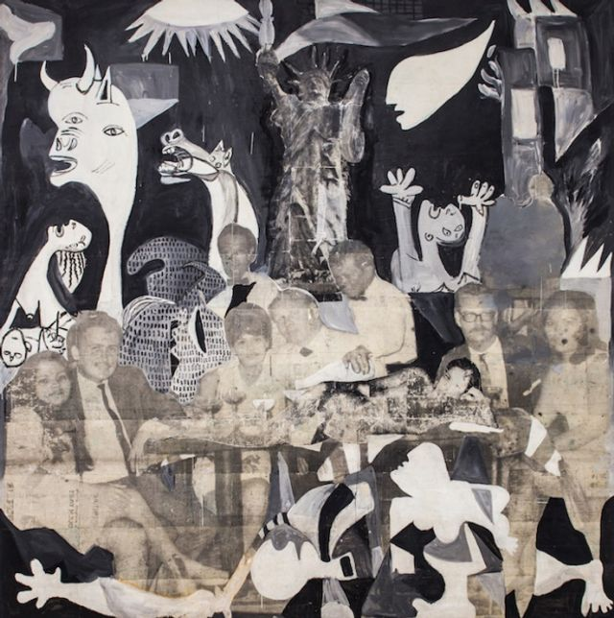
Get to Know the Famous Artist
Santiago Bose
Most prolific, indigenous and Innovative artist in the Philippines
Bricolage style artwork.
Make use of indigenous materials such as bamboo, volcanic ash, and photographs.
image from Google
9-11 Return of the Comeback

Slide 10
Heart Work Activity
Task for the Day:
What does the song “Tatsulok” and suppress Freedom mean to you?
You can use digital or traditional way of presenting your artwork
(e.g. pen, pencil, water color, photography, etc)

Slide 11
Reference:
Artlist Team (2020, August). Art-List Feature: Santiago Bose, Painter and Magician. Retrieved from https://www.art-list.com/blog/artlist-feature-santiago-bose
Badgely, L. (n.d). 40 Clever and Meaningful Collage Art Examples. Retrieved from https://www.pinterest.ph/pin/441915782167372866/
Blograma (2016, January). Old Churches in Pen and ink by Nuel Bueza. Retrieved from http://www.macuha-artgallery.com
McArdle, T. (2008). Painting with Mixed Media. Retieved from https://www.art-is-fun.com/painting-with-mixed-media
Nicole Tinkham (2016, March 17). BASIC Pen & Ink techniques to help you get started. Retrieved from
https://keetonsonline.wordpress.com/2016/03/17/7-basic-pen-ink-techniques-to-help-you-get-started/
WooArts.com. (n.d). 33 Astonishing Watercolor Paintings By Erwin Mallari. Retrieved from https://wooarts.com/erwin-mallari/

